Slide 1
European Unemployment:
OuTcomeS and Outlook
Prakash Loungani
Advisor, Research Department, IMF
Co-Chair, Jobs & Growth Working Group, IMF
April 17, 2013
Views expressed are those of the presenter and should not be ascribed to the IMF .
I thank Ezgi Ozturk for excellent research assistance.

Slide 2
Outline
1. Unemployment: outcomes and outlook
2. Diagnosis: cyclical or structural?
3. IMF advice

Slide 3
1. European Unemployment
Outcomes: Dire
Outlook: Dire

Slide 4
Unemployment Rate:
2012

Slide 5
Change in Unemployment Rate:
2012-2007

Slide 6
Euro Area GDP Growth Forecasts in 2007

Slide 7
Euro Area Unemployment Rate Forecasts in 2007

Slide 8
Unemployment Rate:
2013 WEO Forecast

Slide 9
2. Diagnosis:
Cyclical or Structural
Largely cyclical
Risk of turning structural (“hysteresis”)?

Slide 10
A Debate since the 1970s …
“There is sometimes the naïve belief that unemployment must be due to a defect in the labor market, as if the hole in a flat tire must always be at the bottom, because that is where the tire is flat” (Solow, 2000).
"It takes a heap of Harberger triangles to fill an Okun's gap.” (Tobin, 1977)
“We impute the higher [European] unemployment to welfare states' diminished ability to cope with more turbulent economic times, such as the ongoing restructuring from manufacturing to the service industry, adoption of new information technologies, and a rapidly changing international economy. “
(Ljungqvist and Sargent, 1998)

Slide 11
Unemployment during the Great Recession
Initial increase cyclical rather than structural
Greater uncertainty about relative proportions now, but remains largely cyclical in our view
    Beveridge curve quite stable; moreover shifts may not be sign of increase in natural rate (Diamond 2013)
    Other measures of mismatch back to normal
    Lack of deflation not a sign of small unemployment gap
Stability of Okun’s Law (even during the Great Recession) suggests jobs will return if the growth returns.
    Hence focus of IMF policy recommendations remains on getting growth back
11

Slide 12
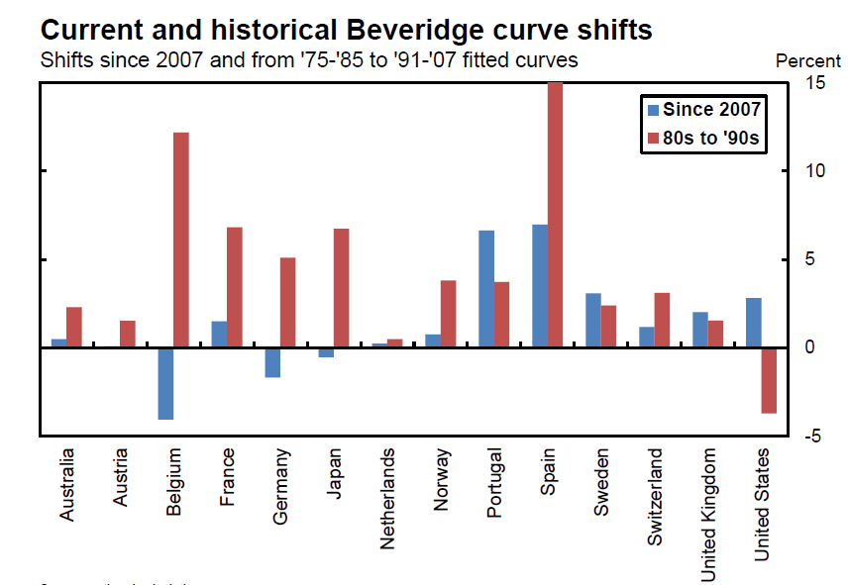
Stability in Beveridge Curve in Most Countries
(relative to past changes)
Graph shows average percent point deviation in the unemployment rate.
Source: Hobijn and Sahin (2012)

Slide 13
Correlation between Change in Unemployment and Change in GDP
(2012, in percent)

Slide 14
Correlation between Change in Unemployment and Change in GDP
(2012, in percent)

Slide 15
3. IMF Advice

Slide 16
Framework
Large increase in unemployment in advanced economies during the crisis
  Cyclical or structural unemployment?
  How to achieve the relative price adjustment in periphery Euro countries?
  Can labor market reforms reduce the natural unemployment rate and raise potential growth?
Recent Staff Discussion Note (Blanchard, Jaumotte, Loungani) looks at IMF advice in this light
16

Slide 17
Recommendations: Monetary & Fiscal Policy
Diagnosis that unemployment problem is largely cyclical has framed IMF advice on labor markets
Fiscal stimulus and monetary easing early in the crisis
Now, fiscal consolidation
  should be gradual, with credible medium-term plans
Effects of fiscal consolidation on growth should be offset by other measures to the extent possible
  Continued ease in monetary policies
  Financial sector repair & reform
17

Slide 18
IMF leadership on fiscal issues widely recognized …
How the IMF became the friend who wants us to work less and drink more
-- Washington Post
April 16, 2013
“It is to the credit of the economists at the Fund that their recommendations to policymakers have adapted to this strange world we’re living in rather than sticking with their more normal, doctrinaire advocacy of monetary and fiscal restraint.”
IMF Renews Push Against Austerity

Slide 19
IMF leadership on fiscal issues widely recognized …
How the IMF became the friend who wants us to work less and drink more
-- Washington Post
April 16, 2013
“It is to the credit of the economists at the Fund that their recommendations to policymakers have adapted to this strange world we’re living in rather than sticking with their more normal, doctrinaire advocacy of monetary and fiscal restraint.”
IMF Renews Push Against Austerity
-- Wall Street Journal
April 17, 2013

Slide 20
“IMF Renews Push Against Austerity”
“ … the International Monetary Fund called on countries that can afford it -- including the U.S. and Britain -- to slow the pace of their austerity measures.”
“The fund warned that "overly strong" belt-tightening in the U.S. will slow growth this year. Across-the-board government spending cuts, known as the sequester, were the "wrong way" to shrink the budget deficit, it said in its semiannual report on economic growth. Those cuts should be replaced by more targeted reductions that would take effect further down the road -- after the economy gains strength, the report said.”
“The U.K. government, which in 2010 embarked on a closely watched effort to escape its slump through tax increases and spending cuts, also should consider easing up on its austerity drive amid a weak recovery there, the IMF said. And it warned euro-area policy makers against focusing too much on hitting tough deficit targets, saying they risked further deepening their downturn.

Slide 21
“IMF Renews Push Against Austerity”
“ … the International Monetary Fund called on countries that can afford it -- including the U.S. and Britain -- to slow the pace of their austerity measures.”
“The fund warned that "overly strong" belt-tightening in the U.S. will slow growth this year. Across-the-board government spending cuts, known as the sequester, were the "wrong way" to shrink the budget deficit, it said in its semiannual report on economic growth. Those cuts should be replaced by more targeted reductions that would take effect further down the road -- after the economy gains strength, the report said.”
“The U.K. government, which in 2010 embarked on a closely watched effort to escape its slump through tax increases and spending cuts, also should consider easing up on its austerity drive amid a weak recovery there, the IMF said. And it warned euro-area policy makers against focusing too much on hitting tough deficit targets, saying they risked further deepening their downturn.”

Slide 22
“IMF Renews Push Against Austerity”
And it warned euro-area policy makers against focusing too much on hitting tough deficit targets, saying they risked further deepening their downturn.
"Fiscal adjustment needs to proceed gradually, building on measures that limit damage to demand in the short term," the IMF said.
The IMF also called on countries like Germany that have traditionally relied on exports for growth to lift spending to stimulate their economies and, the IMF hopes, imports from the country's struggling neighbors.
"There is a need for higher demand" in countries with big trade surpluses, IMF Managing Director Christine Lagarde said in a speech last week. "For countries in Northern Europe, like Germany, it means doing more to boost investment."

Slide 23
Recommendations: Labor Market Policies
Extension of unemployment benefits
    Iceland, Greece
    But reduction in Portugal
Targeted interventions to help some groups
    Youth; Low-skilled; Long-term unemployed (see chart that follows)
Move away from duality
    Too late to stop layoff of temporary workers
    But reduction in employment protection on permanent contracts could help hiring as recovery takes hold
23

Slide 24
‘Recovery’ differs across groups

Slide 25
Competitiveness
In some Euro area countries, need reduction in relative wages
Best way to achieve would be through national tripartite agreement
    Experience of Latvia, Ireland, Greece
Without such an agreement
    More flexibility in wage-setting
    Reduction in public sector wages
    Reduction in minimum wage
    Fiscal devaluations
Higher inflation in North relative to South
25

Slide 26
Medium-run Growth
Higher potential growth and lower natural rate of unemployment desirable
Product market reforms
  essential for medium-run but can hurt in the short-run
Labor market reforms
  move away from duality
  more flexible wage-setting
  Reduce tax distortions to raise participation, particularly for females
  Raising retirement age and adjusting benefits to raise participation of older workers
26

