Slide 1
Private Equity Briefing
Eileen Appelbaum
Center for Economic and Policy Research
February 9, 2012

Slide 2
OUTLINE
PE Model
Sources of PE returns
PE and Job Creation/Destruction
OpCo/PropCo model in retail
PE and Returns to Investors
PE and Risk of Bankruptcy

Slide 3
PE Model
PE firms recruit investors for investment fund
Fund structured as partnership, typical life = 10 years
Sponsoring PE firm is general partner
Investors in fund are limited partners
Investment fund takes control of operating companies it acquires
Little equity, lots of debt– to be paid back by acquired company
VC fund is different, takes equity stake in early stage company
‘2 and 20’ model
Notes:
A recent study of 144 LBO funds that appear to be representative of the industry found that all 144 charged 20% carry. (Metrick and Yasuda, 2009)

Slide 4
Scale of PE Activity
Wharton Private Equity 2011:
PE buyout funds have capital of about $1.3 trillion globally
With leverage, investment portfolio is 3 or 4 times as large
Private Equity Growth Capital Council 2011:
2,300 PE firms headquartered in US
8.1 million employees on payrolls of PE-backed companies
Pitchbook data (January 2012):
16,320 PE-backed companies headquartered in the US
6,986 US companies are currently private equity-owned.

Slide 5
Sources of Gains to PE Investors
Primary goal: maximize returns for investors
Operations engineering – increase profit margins
Increase multiple at which company can be sold
Financial engineering
Leverage
Dividend recapitalizations
Management fees
Looting - bankruptcy for profit (Ackerlof and Romer 1993)
Breach of trust (Schleifer and Summers 1988)

Slide 6
Dividend Recapitalization
More debt piled on to pay PE investors large dividend
Undermines argument that PE returns due to improvements in firm performance and high exit price
Harry & David
Some PE firms accused by creditors of ‘bleeding-out’ company, causing it to become insolvent
Sun Capital faces such an accusation in relation to Mervyn’s
Apax Partners and TPG Capital face similar with TIM Hellas
Some PE investors concerned won’t recoup investment
Urban Brands (Ashley Stewart & Marianne stores)
Hospital Corporation of America (HCA)

Slide 7
Management Fees and Investor Returns (Metrick & Yasuda 2009)
PE firm collects 2% on all committed capital*
Annual charge is 2% first 5 years, may decrease after
Have incentive to raise larger and larger funds
Revenue per $ of committed funds decreases as funds grow in size, but larger funds => higher management fees and earnings for GP
*Plus transaction fee (buying/selling), fee for monitoring portfolio firm – collected from portfolio firm, shared with LPs; plus ‘establishment fee’ of up to $1 million from LPs

Slide 8
Bankruptcy for Profit?
“…only a small minority of pre-default [PE] owners retains control of companies”
(Hotchkiss, Smith & Strömberg. PE and Resolution of Financial Distress, 2011:4)
Sun Capital Portfolio Company Bankruptcies
Friendly’s Ice Cream LBO 2008
Fluid Routing Systems LBO May 2007
Big 10 Tire LBO Nov 2006
Anchor Blue – LBO Nov. 2003

Slide 9
Breach of Trust
Breaching implicit contracts with stakeholders may increase shareholder returns at expense of stability and long-term competitiveness of firm
May default on implicit contracts managers had established prior to buyout (e.g., workers, vendors)
Examples
Mervyn’s – vendors
EMI – talent pipeline/knowledge workers
Stuyvesant Town/Peter Cooper Village – renters
Cadbury’s – community
Antitrust suit – shareholders in publicly-traded firms

Slide 10
Private Equity and Jobs Davis et al. 2008 vs. Davis et al. 2011
Compare employment dynamics in “targets” acquired by PE in LBO 1/1980 – 12/2005 with “controls”
Same data sets and methodology used in both, but
Results in 2008 far less favorable to PE
But even in 2011, no support: “employment grows a tad more slowly in PE than in non-PE owned companies”
Acquiring a company and its employees does not count as job creation

Slide 11
PE and Jobs: Results from 2008 Study
Establishments
“…five years after the transaction, the targets have a level of employment that is 10.3% lower than it would be if targets had exhibited the same growth rates as controls” (p. 50)
Firms - restricted sample b/c matching issue, firm deaths
Jobs analysis includes greenfield sites, acquisitions, divestitures
Two years after transaction: “targets have a 3.6% lower net employment growth rate than controls over this period” (p. 52)
Target firms shut down twice as many establishments than controls

Slide 12
PE and Jobs: Results from 2011 Study
Establishments
“Perhaps surprisingly, …[there is] no systematic pattern of slower job growth at targets in the years leading up to buyout transactions. In the transaction year itself, employment growth at targets is actually 2 percentage points higher than at controls. However, there is a clear pattern of slower growth at targets post buyout, with growth differentials ranging from 0.5% to 2% per year. These differentials cumulate to 3.2% of employment in the first two years post buyout and 6.4% over five years.” p. 17
“Slower employment growth at PE targets post buyout entirely reflects a greater pace of job destruction” pp. 17-18; half due to closings
In retail, employment falls by nearly 12% in targets relative to controls

Slide 13
PE and Jobs: Results from 2011 Study
Firms
Continuers and deaths: “Summing these two components yields a two-year employment growth rate differential of -5.49 percentage points (-1.36 -4.13) for targets, a large difference” p. 23
Adding in greater job growth for targets than controls at greenfield establishments (+1.87)” yields a differential of -3.62 percentage points for targets” p. 23
Only when acquisitions are included does the employment growth differential shrink to less than 1%
“Finally, bringing in the role of acquisitions and divestitures reduces this differential to -0.81 points …” p. 23

Slide 14
Why So Much Job Destruction in Retail?
Competitive pressure on retailers
Wal-Mart, Target, Sam’s Club and Amazon and others
Applies equally to retailers that are PE targets and other retailers
OpCo/PropCo model in retail (other w/large RE assets)
Retail highly cyclical: traditionally low debt, own store properties
PE splits retail chain into operating company that runs the stores, property company that owns the real estate, sells to REIT
OpCo pays rent to PropCo
W/O cushion and w/high rent, any trouble = distress

Slide 15
Measuring Fund Returns (Kaplan and Schoar 2005) vs.(Harris, Jenkinson and Kaplan 2011)
Venture Economics data (2005) from reporting by GPs & LPs
“[w]e believe that if there is a bias it would most likely take the form of underreporting by worse performing funds. ….this would create an upward bias on our results on average returns.” p. 1794
VE data (2011)
“VE PMEs are lower than those of the other three commercial databases….We interpret our results as suggesting that it is highly likely that the VE returns understate buyout fund performance.” pp. 3-4
Burgiss data (2011) from LPs that use Burgiss system
Unknowable (self) selection bias in both data sets

Slide 16
Method to Compare PE Returns to S&P: 2005 vs. 2011
Public Market Equivalent (PME) compares LP return net of fees to equivalent investment in S&P 500
Private Equity Returns (2005)
Sample includes only funds that are liquidated
Inflows are actual cash flows to LPs, not subjective estimates
Private Equity Returns (2011)
Sample includes funds that have not exited all investments
Distributions include estimated value of unrealized (illiquid) investments in portfolio companies

Slide 17
Unrealized Investments as % of Fund Holdings (2011 analysis)
Unrealized investments are less than 3% for median fund pre-1999
10% for median 1999 fund, 38% for median 2000 fund
55% for median 2002 fund, 71% for median 2003 fund, exceed 80% for vintages after 2003
From 2002 on, more than half the ‘distributions’ are subjective estimates, not money to take to bank

Slide 18
LP Returns Net of Fees Relative to S&P 500
Kaplan & Schoar 2005: Vintage 1984-1997
On average, investing in S&P 500 beats PE
Only top quarter of PE funds beats market on average
Equal weighted: Median = 0.80, Av = 0.97, 25%ile = 0.63, 75%ile = 1.12
Size weighted: Median = 0.83, Av = 0.93, 25%ile = 0.72, 75%ile = 1.03
Harris, Jenkinson & Kaplan 2011: Vintage 1984-2008
On average, PE beats investing in S&P 500
Includes estimates of returns for companies still in portfolio
Equal weighted: Median = 1.16, Average = 1.22
Size weighted: Average = 1.27

Slide 19
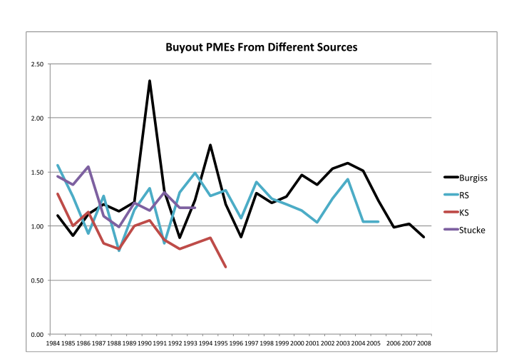
Returns to PE/Returns to S&P 500 (Public Market Equivalent)
Harris, Jenkinson and Kaplan 2011

Slide 20
Risk of Bankruptcy Strömberg 2008 vs. Hotchkiss, Smith & Strömberg 2011
“Proponents have identified benefits of LBOs … Relatively less attention has been given to the potential downside of these transactions, namely that their high debt levels greatly increase the risk of financial distress” HH&S, p. 2
2008: Compares PE and publicly traded firms
PE-owned companies have substantially higher levels of debt
For LBOs completed between 1970 and 2002
7% became bankrupt while in PE hands
Study ends before severe recession & financial crisis late 2000s
Twice annual bankruptcy rate of publicly traded: 1.2% vs. 0.6%

Slide 21
Risk of Bankruptcy (2011)
Compares highly leveraged PE firms with other highly leveraged firms (spillover: Booz-Allen-Hamilton; YRC)
2,156 firms, half PE-owned, Jan 1997-Apr 2010
No surprise - both have high default rates
5.1% for PE-backed firms vs. 3.4% for non PE-backed
In period since financial crisis, default rate for highly leveraged firms increased to 25%
PE sponsors help facilitate restructurings
Nevertheless, recovery rates to creditors are lower when company is PE-backed – to bond holders, not banks
Notes:
Bondholders recover less in PE-backed bankruptcies because PE firms better able to negotiate ‘covenant lite’ agreements, so lenders have little early recourse.

Slide 22
Conclusions
PE and Jobs
Greater pace of job destruction in PE-owned companies
PE and Investor Returns
Management fees eat into LP returns
Funds that have closed: Most LPs better off investing in S&P 500
Including guesstimates of value of illiquid investments in portfolio firms leads to finding that LPs better off in PE than S&P
PE and Bankruptcy
PE-owned firms twice as likely as comparable publicly-traded companies to default – before post-crisis explosion of bankruptcies
Higher default rate even compared w/ other highly leveraged firms
Lenders fare worse in bankruptcy of PE-owned firms

