Slide 1

Austerity in the Eurozone:
It’s Not Working
Mark Weisbrot
Center for Economic and Policy Research
www.cepr.net

Slide 2
Greece

Slide 3
Most important Problem:
Fiscal policy is pro-cyclical
2010-2011: Greece adopts measures to cut spending by 8.7 percent of GDP
(For comparison: $1.3 trillion in the U.S.)
As the economy shrinks, it becomes harder to make the revenue targets
IMF has been way off in its projections and getting worse:

Slide 4
Greece:
Real GDP Projections
Source: IMF (various) and Hellenic Statistical Authority

Slide 5
Greece:
Unemployment Rate Projections
Source: IMF (various) and Hellenic Statistical Authority

Slide 6
Economic costs so far:
Loss of 15.8 percent of GDP (among worst of past century’s financial crises)
20.9 percent unemployment (Nov.); still more than 17 percent by 2016 (IMF)
Minimum wage cut 20 percent (32 for those under 25)
Mass layoffs (150,000 public workers by 2015)
Cuts to health and education

Slide 7
Social costs:
Kentikelenis et al. 2011. The Lancet:
“Suicides rose by 17% in 2009 from 2007 and unofficial 2010 data quoted in parliament mention a 25% rise compared with 2009. The Minister of Health reported a 40% rise in the first half of 2011 compared with the same period in 2010 […] Violence has also risen, and homicide and theft rates nearly doubled between 2007 and 2009.”
52 percent increase in HIV 2010-2011.

Slide 8
Greece
Employment as a Percent of Working Age Population
Source: Eurostat

Slide 9
Strategy
“Internal Devaluation”
Not Working
Real effective exchange rate still higher than in 2006

Slide 10
Greece:
Real Effective Exchange Rate
Source: Eurostat

Slide 11
Greece:
Debt as a Percent of GDP Scenarios
Source: IMF (various) and Weisbrot and Montecino (2012)

Slide 12
EU Net Interest Burden
(Percent of GDP)
Source: IMF and Eurostat

Slide 13
Alternatives
ECB, European authorities could reverse course and allow for expansionary fiscal policy in Greece and Eurozone – but won’t

Slide 14
Default and Exit:
Argentina
Banking system collapsed, but only one quarter of continued recession
Then growth: 63 percent in six years
Recovers pre-crisis GDP within 3 years
Allow 2/3 reduction in poverty and extreme poverty
Large increases in social spending, reduced inequality
Huge Success

Slide 15
Argentina vs. Greece
Comparative GDP Recovery Paths: Argentina (1996-2007) vs. Greece (2005-2016)
Source: Weisbrot and Montecino (2012)

Slide 16
Argentine Recovery Misunderstood
Not a commodities boom
Not even export led
Led by domestic consumption and investment
Change in macroeconomic policy was key: change from pro-cyclical to pro-growth

Slide 17
Greek advantages over Argentina
Export sector twice as big
More potential sources of borrowing, if needed
More developed economy, banking system

Slide 18
Outlook for Greece
Sizeable probability of default/exit on current path
Much more pain and slow recovery projected, at best
Default/exit, if done right, could bring much faster recovery after initial crisis
A responsible government should consider this option seriously

Slide 19
Eurozone in Recession
“The balance of risks to Europe’s near-term growth remains to the downside … a renewed escalation of the euro crisis remains a possibility so long as the underlying issues are not resolved.”
-IMF WEO April 2012

Slide 20
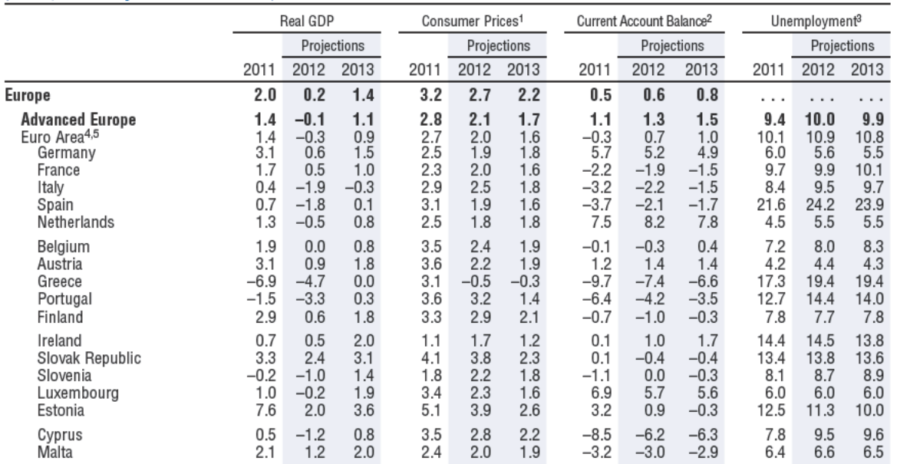
European Outlook
Source: IMF WEO (Spring 2012)

Slide 21
Euro Area
Annualized Quarterly Growth
(2005 Constant Seasonally Adjusted Euros)
Source: Eurostat

Slide 22
Germany
Annualized Quarterly Growth
(2005 Constant Seasonally Adjusted Euros)
Source: Eurostat

Slide 23
France
Annualized Quarterly Growth
(2005 Constant Seasonally Adjusted Euros)
Source: Eurostat

Slide 24
Netherlands
Annualized Quarterly Growth
(2005 Constant Seasonally Adjusted Euros)
Source: Eurostat

Slide 25
Ireland
Annualized Quarterly Growth
(2005 Constant Seasonally Adjusted Euros)
Source: Eurostat

Slide 26
Portugal
Annualized Quarterly Growth
(2005 Constant Seasonally Adjusted Euros)
Source: Eurostat

Slide 27
Italy
Annualized Quarterly Growth
(2005 Constant Seasonally Adjusted Euros)
Source: Eurostat

Slide 28
Spain
Annualized Quarterly Growth
(2005 Constant Seasonally Adjusted Euros)
Source: Eurostat

Slide 29
Greece: Unemployment Rate
(Projections Start in 2012)
Source: IMF WEO

Slide 30
Ireland: Unemployment Rate
(Projections Start in 2012)
Source: IMF WEO

Slide 31
Portugal: Unemployment Rate
(Projections Start in 2012)
Source: IMF WEO

Slide 32
Spain: Unemployment Rate
(Projections Start in 2012)
Source: IMF WEO

Slide 33
Change in REER: 2006Q1-2011Q3
(Deflated by Consumer Price Index and Unit Labor Costs)
Source: Eurostat

Slide 34
Spain: National Accounts
Contributions to Growth
(2005 Constant Euros)
Source: Eurostat and Ministry of Finance Spain

Slide 35
Spain: National Accounts
Contributions to Growth
(2005 Constant Euros)
Planned Gov.
Cuts
Source: Eurostat and Ministry of Finance Spain

Slide 36
Youth Unemployment
(Percent of Labor Force Under 25)
Source: Eurostat

Slide 37
EU Net Interest Burden
(Percent of GDP)
Source: IMF and Eurostat

Slide 38
Alternatives
Interest burden is what matters most
ECB can keep that from growing

Slide 39
Fiscal Tightening
Ireland: Spending cut by €6.5 billion between 2008-2011 (3.6 percent of 2008 GDP or 4.2 percent of 2011 GDP)
France: Sarkozy pledges balanced budget by 2016 (deficit currently 5.3 percent of GDP)
Spain: €27 billion in cuts from 2012 budget (2.3 percent of GDP in one year)

Slide 40
Conclusion
Europe’s crisis is not a debt crisis but a crisis caused by bad policy
It has slowed world growth significantly and could do so again
Feasible alternatives are available: ECB especially can end the crisis with bond purchases but refuses to do so
Individual countries should consider other options, including exit – may be less costly

