Slide 1
ENSURING
AN EuropEan RECOVERY
Prakash Loungani
Advisor, Research Department, IMF
Co-Chair, Jobs & Growth Working Group, IMF
October 12, 2013
Views expressed are those of the presenter and should not be ascribed to the IMF .
I thank Ezgi Ozturk for excellent research assistance.

Slide 2
Outline
1. Recovery is here (fingers crossed)
Why did it take so long?
    Comparison with Asian crisis countries
    Comparison with previous global recoveries
How to keep it going

Slide 3
1. Recovery is here
(fingers crossed)

Slide 4






The annual projections …
WEO Real GDP Growth Projections
(percent change from a year earlier)
 | World | U.S. | Euro Area | Japan | Brazil | Russia | India | China
2013 (Oct. 2013) | 2.9 | 1.6 | -0.4 | 2.0 | 2.5 | 1.5 | 3.8 | 7.6
2013 (Jul. 2013) | 3.1 | 1.7 | -0.6 | 2.0 | 2.5 | 2.5 | 5.6 | 7.8
2014 (Oct. 2013) | 3.6 | 2.6 | 1.0 | 1.2 | 2.5 | 3.0 | 5.1 | 7.3
2014 (Jul. 2013) | 3.8 | 2.7 | 0.9 | 1.2 | 3.2 | 3.3 | 6.3 | 7.7
Source: IMF, World Economic Outlook.
8

Slide 5
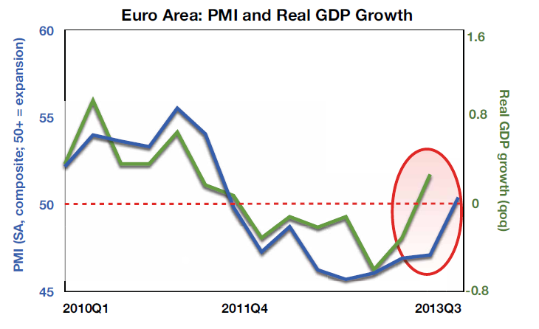
A closer look

Slide 7
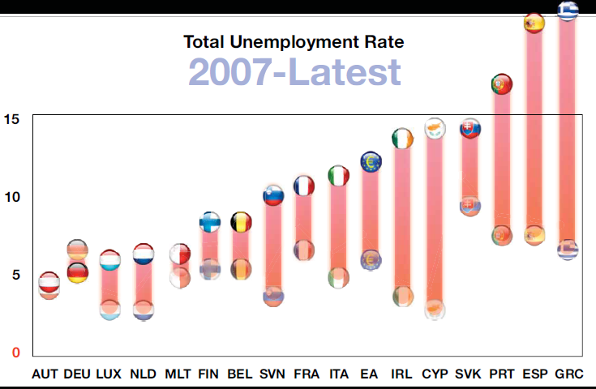
A dire unemployment situation

Slide 8
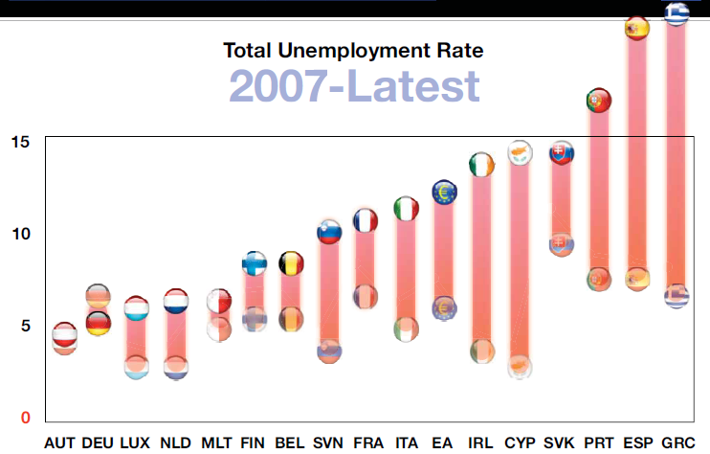
A lost generation?

Slide 9
Correlation between Change in Unemployment and Change in GDP
(2012, in percent)

Slide 10
2. Why did it take so long?

Slide 11
Europe had worse initial fiscal position than Asian crisis countries
Data for Asian and European countries is for respectively 1996 and 2009.

Slide 12
Asia adjusted more via exchange rates,
Europe via domestic adjustment
REER adjustment measured over 1997-98 for Asian countries and 2010-12 for European countries. Fiscal adjustment measured as change in fiscal balance between 1996-2000 for Asian countries and 2009-2012 for European countries.

Slide 13
EUR access higher in % quota but not in % of financing needs
Financing needs comprise current account balance and short-term debt (at remaining maturity). For Korea, short-term debt is on a maturity basis. The first Greek program (GRC1) was not fully disbursed.

Slide 14
Asia rebounded faster
Simple group averages of real GDP levels

Slide 15
A Recovery on Track?
World Real GDP per capita

Slide 16
The Divergence in Recovery between Advanced Countries and Emerging Markets

Slide 17
Divergence in Government Spending between this Global Recovery and Past Global Recoveries

Slide 18
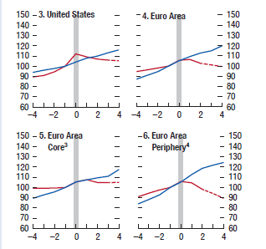
Divergence in Government Spending between this Global Recovery and Past Global Recoveries:
US and Euro Area

Slide 19
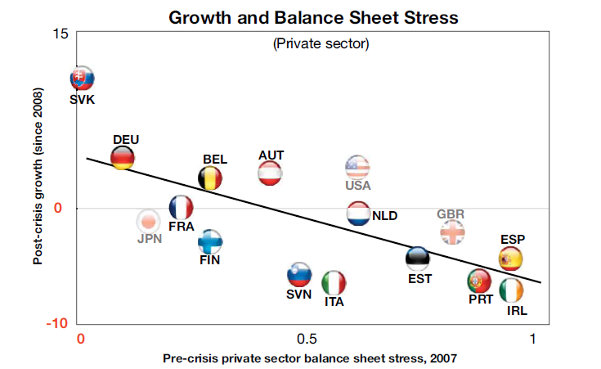
Deleveraging

Slide 20
3. How to keep it going

Slide 21
The (overloaded) policy agenda
Banking union
Macro policies
  Fiscal
  Monetary
Labor market & structural policies
**
External conditions
  US monetary policy actions
  Emerging market growth

Slide 22
Banking union
Ongoing reforms should be expedited, including a final agreement on the Bank Recovery and Resolution and Deposit Guarantee Scheme (DGS) Directives by the European Parliament.
European partners should agree on a strong resolution mechanism based on a centralized authority, supported by a common fiscal backstop, with powers to trigger resolution and make decisions on burden-sharing to ensure timely and least-cost resolution.

Slide 23
Fiscal policy
Fiscal consolidation inevitable in high-debt countries, but it also reduces short-term growth. Getting the pace and composition of consolidation right is therefore essential.
The pace and composition of adjustment should be attuned to country circumstances.
  Pace: Where financing allows, adjustment should be conducted at a gradual pace that balances the need to reduce structural deficits against that of not undermining the recovery, and automatic stabilizers should be allowed to operate.
  Composition: The expenditure and revenue mix in adjustment plans should be calibrated to reduce negative short-term effects on economic activity, while enhancing long-term growth prospects and protecting the most vulnerable.
Fiscal adjustment should be based on credible medium-term plans.

Slide 24
Monetary policy
Forward guidance that rates will remain low
But also dependent on US monetary policy actions

Slide 25
US conditions
Unemployment Rate
(percent)
Government Bond Yields and GDP Growth From Consensus Forecast
(percent
May 22, 2013
Sources: Bloomberg, L.P., Consensus Forecast; and IMF staff estimates.

Slide 26
Impact on Europe from US developments
Policy Rate Expectations 1/
(percent; months on x-axis; dashed lines are from the April 2013 WEO)
Key Interest Rates 2/
(percent)
Sep.
13
Source: Bloomberg, L.P.
1/ Expectations are based on the federal funds rate for the United States, the sterling overnight interbank average rate for the United Kingdom, and the euro interbank offered forward rate for Europe; updated September 24, 2013.
2/ Interest rates are 10-year government bond yields unless noted otherwise.

Slide 27
Inflation and inflation expectations remain subdued
But inflation pressures are very low. Thus, our WEO assumes that monetary policy stays very accommodative in advanced economies.
Global aggregates: Headline Inflation
(year-over-year percent change; dashed lines are the six-to-ten-year inflation expectations)
14:
Q4
Sources: Consensus Forecast; and IMF staff estimates.

Slide 28
Getting macro right will help labor markets
“There is sometimes the naïve belief that unemployment must be due to a defect in the labor market, as if the hole in a flat tire must always be at the bottom, because that is where the tire is flat” (Solow, 2000).
"It takes a heap of Harberger triangles to fill an Okun's gap.” (Tobin, 1977)

Slide 29
Framework
Large increase in unemployment in advanced economies during the crisis
  Cyclical or structural unemployment?
  How to achieve the relative price adjustment in periphery Euro countries?
  Can labor market reforms reduce the natural unemployment rate and raise potential growth?
Staff Discussion Note (Blanchard, Jaumotte, Loungani) looks at IMF advice in this light
29

Slide 30
Unemployment during the Great Recession
Initial increase cyclical rather than structural
Greater uncertainty about relative proportions now, but remains largely cyclical in our view
    Beveridge curve quite stable; moreover shifts may not be sign of increase in natural rate (Diamond 2013)
    Other measures of mismatch back to normal
    Lack of deflation not a sign of small unemployment gap
Stability of Okun’s Law (even during the Great Recession) suggests jobs will return if the growth returns.
    Hence focus of IMF policy recommendations remains on getting growth back
30

Slide 31
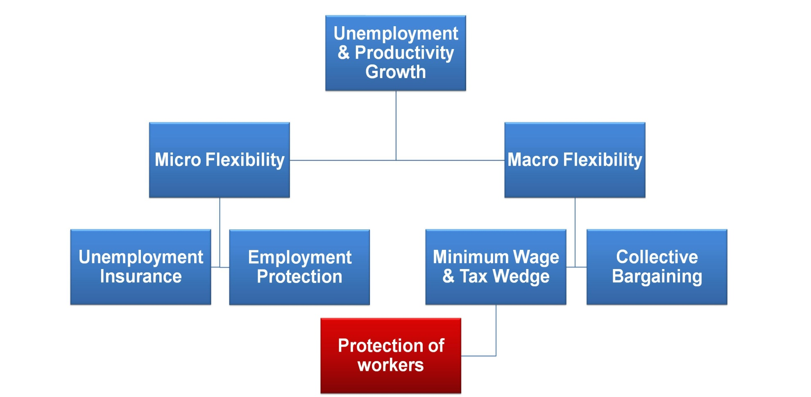
“Labor Market Flexibility”:
Moving Beyond Mantras

Slide 32
Recommendations: Labor Market Policies
Extension of unemployment benefits
    Iceland, Greece
    But reduction in Portugal
Targeted interventions to help some groups
    Youth; Low-skilled; Long-term unemployed (see chart that follows)
Move away from duality
    Too late to stop layoff of temporary workers
    But reduction in employment protection on permanent contracts could help hiring as recovery takes hold
32

Slide 33
‘Recovery’ differs across groups

Slide 34
Competitiveness
In some Euro area countries, need reduction in relative wages
Best way to achieve would be through national tripartite agreement
    Experience of Latvia, Ireland, Greece
Without such an agreement
    More flexibility in wage-setting
    Reduction in public sector wages
    Reduction in minimum wage
    Fiscal devaluations
Higher inflation in North relative to South
34

Slide 35
Medium-run Growth
Higher potential growth and lower natural rate of unemployment desirable
Product market reforms
  essential for medium-run but can hurt in the short-run
Labor market reforms
  move away from duality
  more flexible wage-setting
  Reduce tax distortions to raise participation, particularly for females
  Raising retirement age and adjusting benefits to raise participation of older workers
35

